Slide 1
Control Structures – Selection
Chapter 4

Slide 2
Chapter Topics
Control Structures
Relational Operators
Logical (Boolean) Operators
Logical Expressions
Selection if ( ) and
if ( ) … else
switch Structures
The assert Function

Slide 3
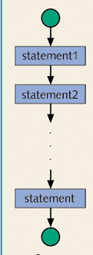
Control Structures
Statements can be
executed in sequence
One right after the other
No deviation from the
specified sequence

Slide 4
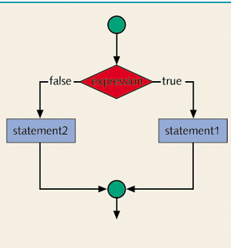
Control Structures
A selection
structure can be
used
Which statement
is executed is
selected by
whether the
expression is true
or false

Slide 5
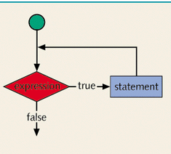
Control Structures
Statements can be
repeated
The number of
repetitions depends
on when the
expression turns false

Slide 6
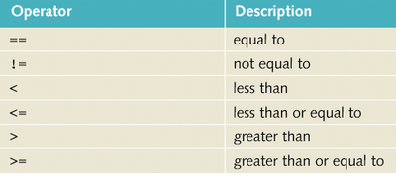
Relational Operators
The expressions which determine
  Selection and
  Repetition are usually comparisons
Comparisons are done with relational operators
Beware of mistaking the assignment = for the equality ==

Slide 7
Relational Operators
Examples:
Expression Meaning Value
8 < 15 8 is less than 15 true
6 != 6 6 is not equal to 6 false
2.5 > 5.8 2.5 is greater than 5.8 false
5.9 <= 7.5 5.9 is less than or
equal to 7.5 true

Slide 8
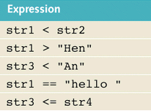

Relational Operators
Given
string str1 = "Hello"; string str2 = "Hi";
string str3 = "Air"; string str4 = "Bill";
string str5 = "Big";
Determine the values of these comparisons using variables

Slide 9
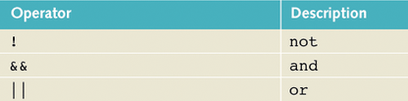
Logical (Boolean) Operators
Logical or Boolean operators enable you to combine logical expressions
Operands must be logical values
The results are logical values (true or false)
A unary operator
Binary operators

Slide 10
Logical (Boolean) Operators
The && operator (logical and)
  If both operands are true, the result is true
  If either or both operands is false, the comparison is false
The || operator (logical or)
  If either or both of the operands are true, the comparison is true
  The comparison is false only if both operands are false
The ! operator (logical not)
  The not operator reverses the logical value of the one operand

Slide 11
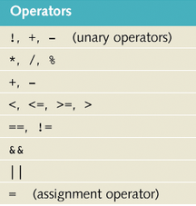
Logical Expressions
We must know the order in which to apply the operators
12 > 7 || 9 * 5 >= 6 && 5 < 9
Highest
Lowest
View Sample Program
Order of Precedence

Slide 12
Short Circuit Evaluation
Consider
(x != 0) && (1.0 / x < 0.25)
If the first condition is false, the program could crash when it tried to divide by zero
  but if the first condition is false, the whole expression is false
  no need to go on
When C++ evaluates an expression, realizes that fact and does not even make the second comparison
Called "short circuit" evaluation

Slide 13
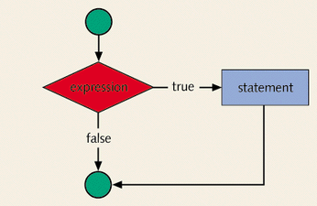
Selection if (...)
C++ has two versions of if statements
In this version, the condition is checked
  If the expression
  is true, the
  statement is
  executed
  If it is false,
  nothing happens

Slide 14
Selection if (...)
Syntax
if ( logicalExpression )
statement;
Example
if (x < 5 )
cout << "low value for x";
Note parentheses around the condition
Note there is no "then" as part of the syntax

Slide 15
Selection if ( ) … else …
Also possible to make two way selection
If the expression is
true, statement1 is
executed
Otherwise statement2
is executed

Slide 16
Selection if ( ) … else …
Syntax
if (condition)
statement1;
else
statement2;
Example
if (x < 5) cout << "low x";
else cout << "high x";
View sample program

Slide 17
Compound Statements
Consider the need for multiple statements to be controlled by the if
This is called
a compound
statement
Group the
statements in
curly brackets
Statement1;
Statement2;
Statement3;

Slide 18
Compound Statements
Example
if (x < 5)
{
x = x + 10;
cout << x;
}
Note the use of indenting and white space in the source code for readability.
The compound statement

Slide 19
Nested if
Syntax calls for a “statement” after the
if ( … )
That statement can be any kind of statement
  (List statements we know about)
It can be an if statement
cout
cin
assignment
if
if (x < 7)
if (y > 5)
cout << “hi mom”;

Slide 20
The Dangling else
How to determine which if the else goes with
Example:
if (abs (x - 7))
if (x < 7) cout << “x approaches 7 from left”;
else
cout << “x approaches 7 from the right”;
else
cout << “x not close to 7”;
?
?
Rule :
An else goes with the closest unmatched if

Slide 21
The Dangling Else
Rule : an else goes with the closest unmatched if
Consider … how do you force an else to go with a previous if?
if (x < y)
if (y > 3) cout << “message about y > 3”;
else cout << “message about x and y”;
Use { curly brackets } to nest the statements
if (x < y)
{ if (y > 3) cout << “message about y > 3”; }
else cout << “message about x and y”;

Slide 22
Multiple Selections
Consider determining a letter grade based on a score
  Cut off points for A, B, C, and D are 90, 80, 70, and 60 respectively
We check the score against each of these values
See source code

Slide 23
Multiple Selections
Contrast
  A sequence of
  if … else if … statements
  A sequence of separate if statements
What happens in each case when it is the first if condition that is true?
  if … else if sequence will jump out of the structure whenever match is found
  sequence of separate if's – each if is checked, no mater where the match is

Slide 24
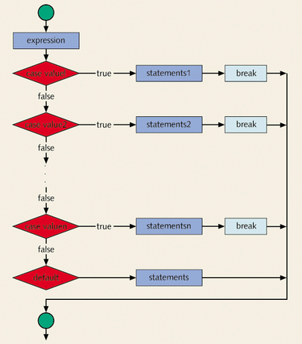
Multiple Selections
Recall the current branching capability provided by the
if ( … ) statement
Only branches two
ways
We desire a more
eloquent way to do
multiway branching

Slide 25
switch Structures
C++ provides the switch statement
switch (choice) {
case 1 : do_option_one(); break;
case 2 :
case 3 : do_2_3_a ();
do_2_3_b (); break;
default : do_something_else (); }

Slide 26
switch Structures
Value of the switch expression matched with one of the labels attached to a branch
The statement(s) with the match get executed
switch (choice) {
case 1 : do_option_one(); break;
case 2 :
case 3 : do_2_3_a ();
do_2_3_b (); break;
default : do_something_else (); }

Slide 27
switch Structures
Switch expression => the expression in parentheses whose value determines which switch label is selected
  cannot be floating point
  usually is int or char
Identifiers
following case
must be constants
switch (choice) {
case 1 : do_option_one(); break;
case 2 :
case 3 : do_2_3_a ();
do_2_3_b (); break;
default : do_something_else (); }

Slide 28

switch Structures
The break causes control to be shifted to first statement after the switch statement
the default statement is executed if the value of the switch expression is NOT found among switch labels
switch (choice) {
case 1 : do_option_one();
break;
case 2 :
case 3 : do_2_3_a ();
do_2_3_b ();
break;
default : do_something_else ();
}
// next statement

Slide 29
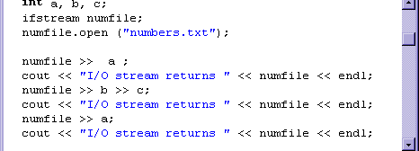
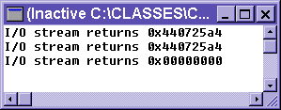
Testing the State of an I/O Stream
The name of the input stream (used by itself) returns a value
  returns a 0 if it is NOT successful
  it returns a NON zero value if it IS successful

Slide 30
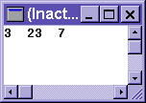
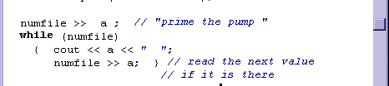
Testing the State of an I/O Stream
When reading a file (a named input stream) we wish to know when it reaches the end
Since the name returns a 0 or non-0, this can be used as a Boolean value
Used to control program sequencing, control a file reading loop

Slide 31
The assert Function
Some statements will compile and run fine in normal situations
Certain values may cause a statement to crash the program
  What might happen in this statement?
  root = -b + sqrt(b * b – 4 * a * c);
The program will crash if it tries to take the square root of a negative number

Slide 32
The assert Function
C++ provides a function which can check specified conditions
  If the condition is true the program continues
  If the condition is false, it will cleanly terminate the program
  It displays a message as to what condition caused the termination
Syntax
assert ( logicalValue);
Note, you must #include <assert>

Slide 33
The assert Function
Example:
assert (b * b - 4 * a * c >= 0);
root = -b + sqrt(b * b – 4 * a * c);
At run time the assertion condition is checked
  If true program continues
  If false, the assert halts the program
Good for debugging stage of your program
  Shows you places where you have not written the code to keep things from happening
  Once fully tested, asserts might be commented out

